Slide 1
Dimensionality Reduction for Machine Learning Representations
Rose K. Cersonsky
16:10 – 17:10, November 16, 2021
Machine Learning Interatomic Potentials Workshop

Slide 2
Today’s Schedule
16:10 – 16:25
Discuss the need for dimensionality reduction and main motivations
16:30 – 16:40
Introduce distance-based mappings: PCA, MDS, PCR
16:55 – 17:05
Discuss complex mappings and non-linear embeddings: KPCA, t-SNE, UMAP
17:05 – 17:10
Open exploration of data & questions
16:25 - 16:30
Questions
16:40 -16:55
Questions & Notebook 1

Slide 3
The Need for and Motivations of Dimensionality Reduction

Slide 4
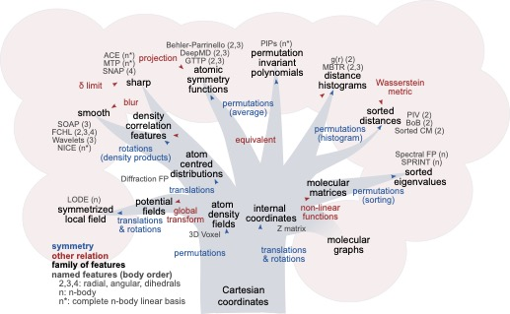
MLIPs require high information density feature sets that mimic the behavior and symmetries of atoms.
Jörg Behler
J. Chem. Phys. 145, 170901 (2016)
https://doi.org/10.1063/1.4966192
Felix Musil, et al.
Chemical Reviews 2021 121 (16), 9759-9815
DOI: 10.1021/acs.chemrev.1c00021

Slide 5
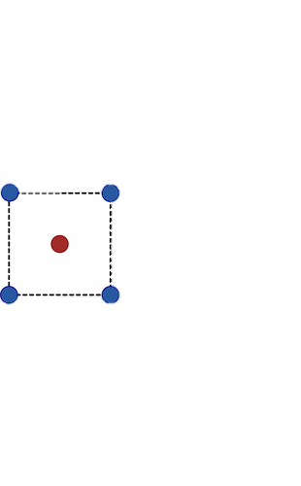
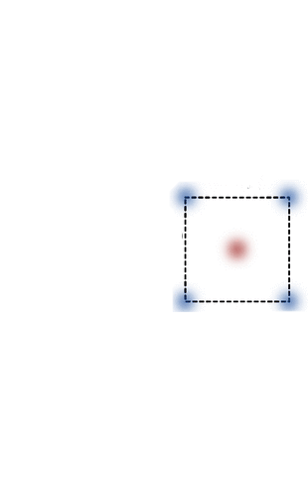
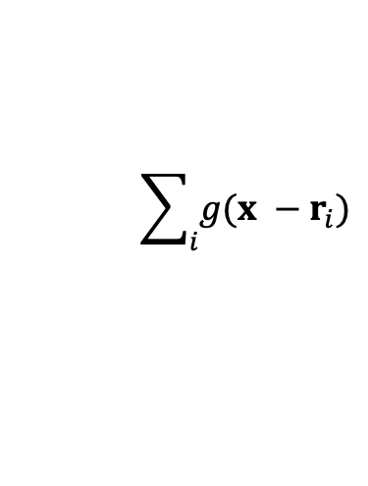
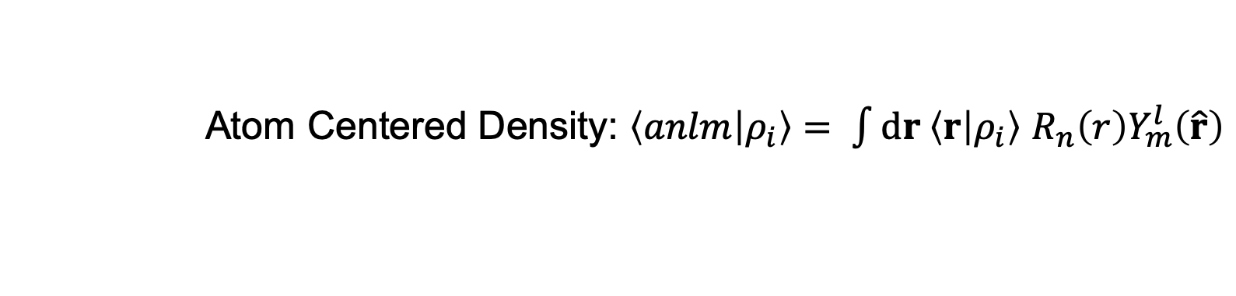
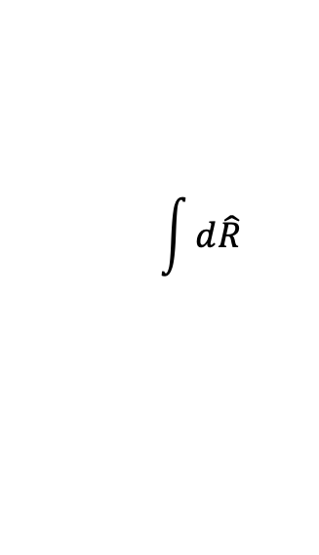
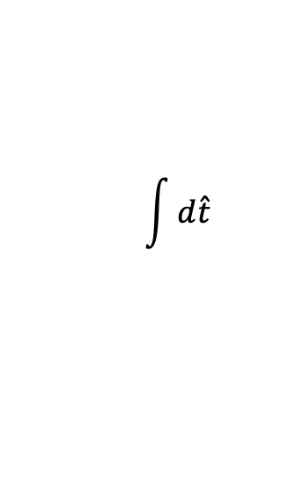
One way to encode the molecular geometry is by assuming a Gaussian centered on each atom, and then integrating over all translations and rotations.
density field
translation average
rotation average
$$\sum_{i}{g(x −r_{i})}$$
$$\int{d\hat{t}}$$
$$\int{d\hat{R}}$$
Atom Centered Density: $\left\langle anlm | ρ_{i}\right\rangle = \int{dr \left\langle r | ρ_{i}\right\rangle }$ $R_{n}\left(r\right)Y_{m}^{l}\left(\hat{r}\right)$
Figure adapted from: F. Musil, et al. Chem. Rev. 2021.

Slide 6
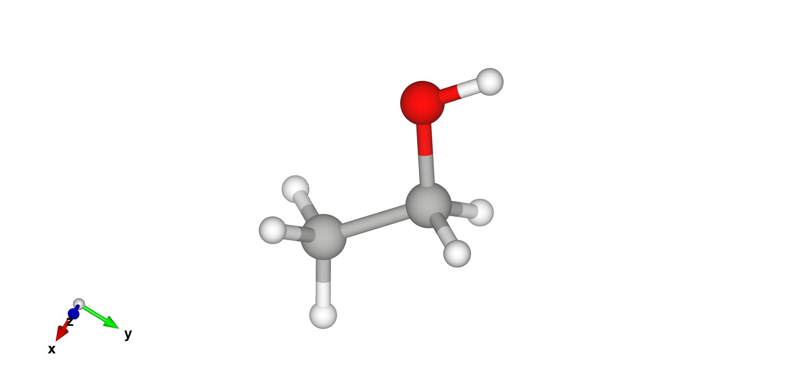
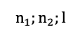
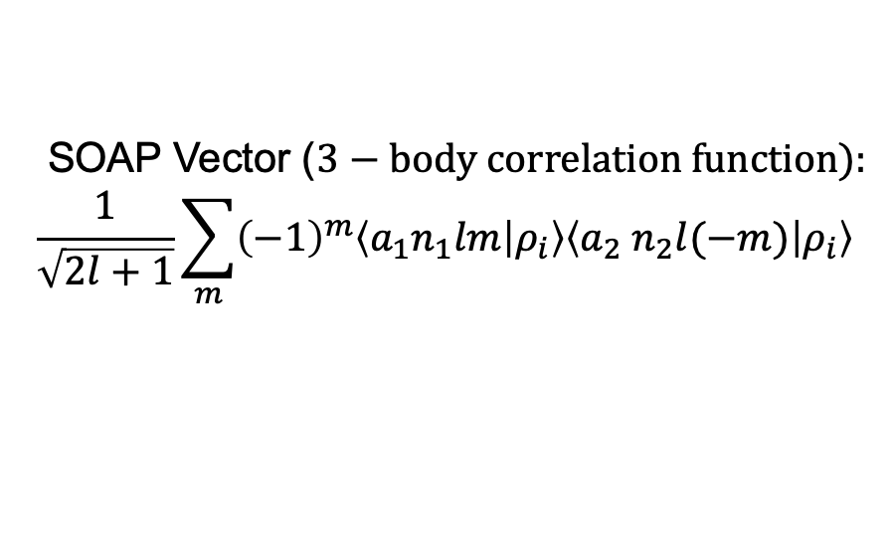
A popular schema for ML models of materials is the three-body SOAP (smooth overlap of atomic positions).
SOAP Vector ($3−body correlation function):$
$$\frac{1}{\sqrt{2l+1}}\sum_{m}{{\left(−1\right)}^{m}\left\langle a_{1}n_{1}lm | ρ_{i}\right\rangle \left\langle a_{2}{ n}_{2}l(−m) | ρ_{i}\right\rangle }$$
$$n_{1};n_{2};l$$

Slide 7
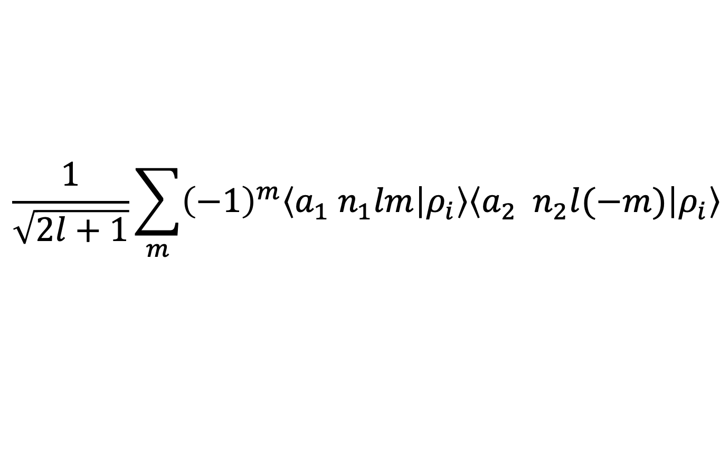
$$\frac{1}{\sqrt{2l+1}}\sum_{m}{{\left(−1\right)}^{m}\left\langle a_{1}{ n}_{1}lm | ρ_{i}\right\rangle \left\langle a_{2}{ n}_{2}l(−m) | ρ_{i}\right\rangle }$$
Accuracy
Dimensionality Reduction
Techniques
Computational
Cost
Interpretability
Number of Features

Slide 8
Motivation 1:
Data Compression
Reduce the dimension of data in a way that preserves as much pertinent information as possible.
Motivation 2:
Data Mapping
Reduce the dimension of data in a way that reveals underlying relationships and phenomena.

Slide 9
The archetypal dimensionality reduction technique: Principal Components Analysis (PCA)

Slide 10
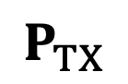
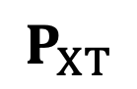
Motivation 1: Data Compression
Reduce the dimension of data in a way that preserves as much pertinent information as possible.
Principal Components Analysis
X
T
$$P_{XT}$$
$$P_{TX}$$

Slide 11
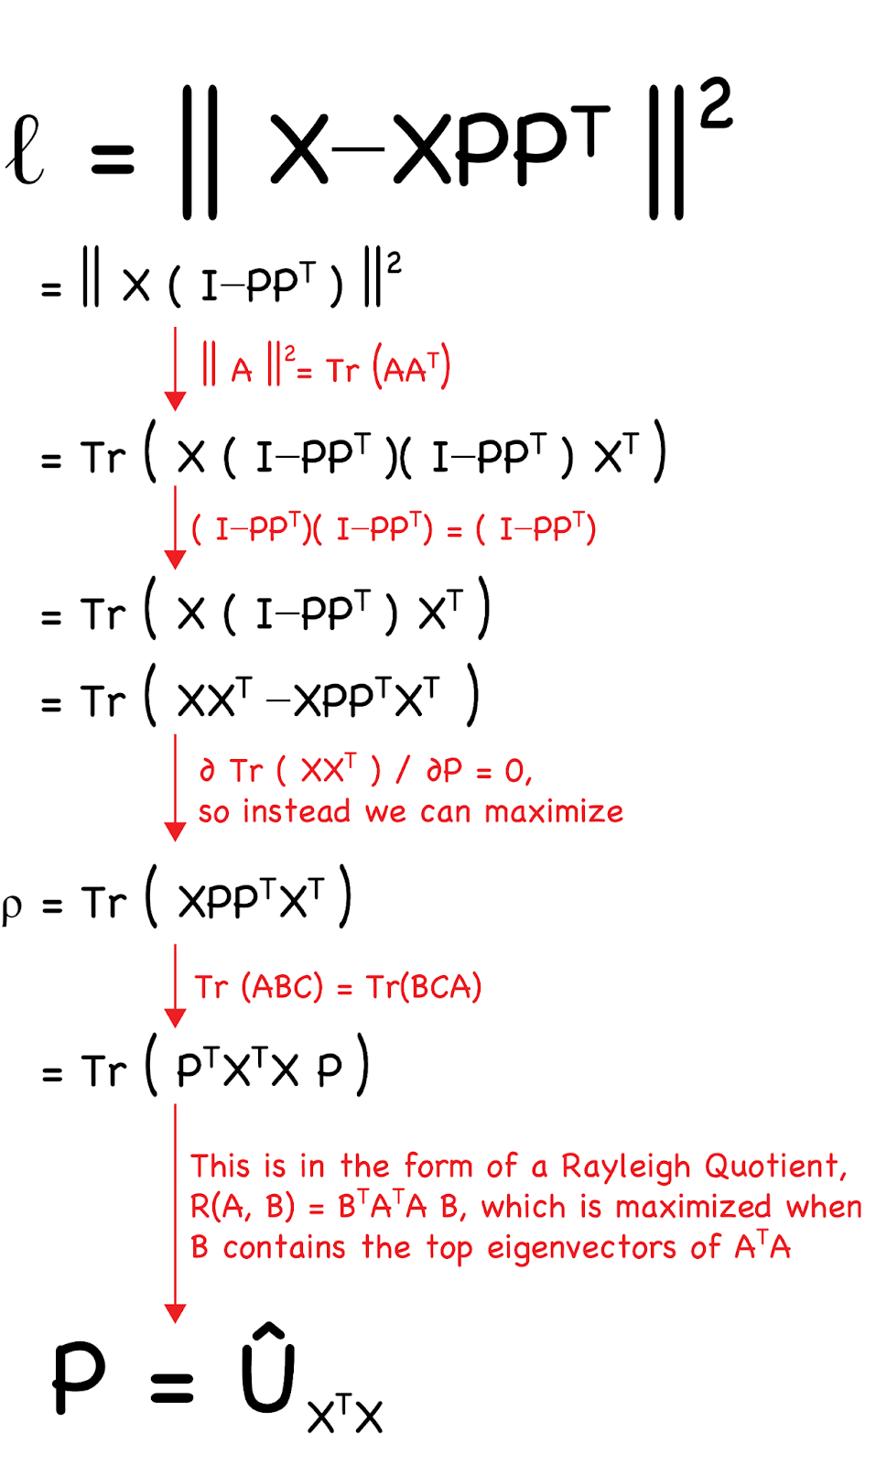
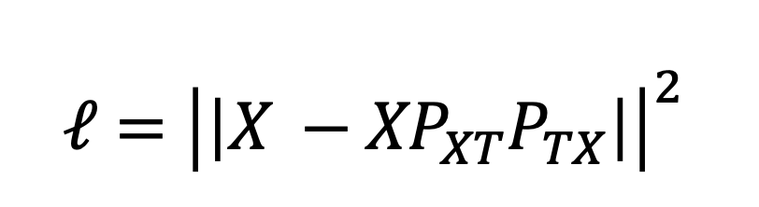
$$ℓ={\left|\left|X −{XP}_{XT}P_{TX}\right|\right|}^{2}$$
?
Meet back at 16:38!

Slide 12
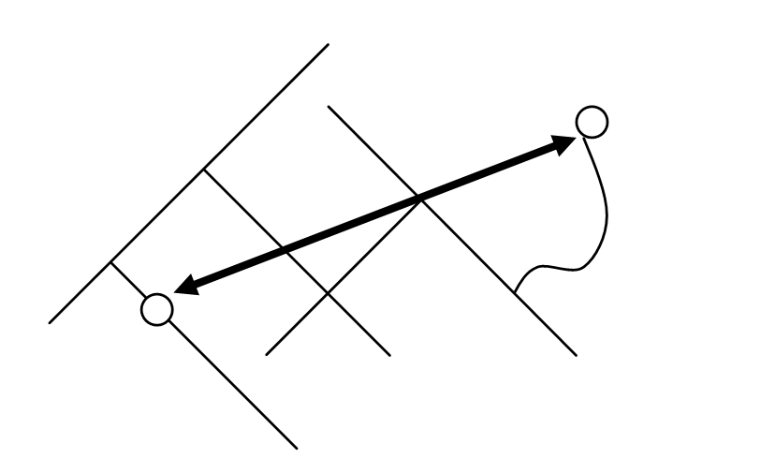
Classical Multidimensional Scaling
Minimize the difference between Euclidean distance in original and latent space
PCA
Maximize the variance retained in the latent-space embedding
PCR
Use the resulting vectors from PCA to compute a linear regression.
Notebook 1
Meet back at 16:55!

Slide 13
Non-linear embeddings and complex mappings

Slide 14
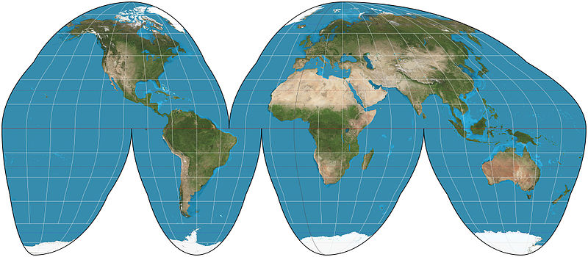
Motivation 2: Data Mapping
Reduce the dimension of data in a way that reveals underlying relationships and phenomena.

Slide 15
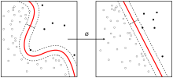
Kernel PCA
Use distances other than Euclidean distance to denote the difference between two samples.
Notebook 2
t-SNE
Minimize difference between original and embedding probability distribution
UMAP
Minimize mismatch between original and embedding network connectivity
Notebook 3

Slide 16
Original Paper Citations:
PCA
Pearson, K. (1901). "On Lines and Planes of Closest Fit to Systems of Points in Space". Philosophical Magazine. 2 (11): 559-572.
MDS
Torgerson, Warren S. "Multidimensional scaling: I. Theory and method." Psychometrika 17.4 (1952): 401-419.
PCR
Kendall, Maurice George. A course in multivariate analysis. No. 311.23 K4. 1957.
Kernel PCA
Schölkopf, Bernhard, Alexander Smola, and Klaus-Robert Müller. "Kernel principal component analysis." International conference on artificial neural networks. Springer, Berlin, Heidelberg, 1997.
t-SNE
Van der Maaten, Laurens, and Geoffrey Hinton. "Visualizing data using t-SNE." Journal of machine learning research 9.11 (2008).
UMAP
McInnes et al., (2018). UMAP: Uniform Manifold Approximation and Projection. Journal of Open Source Software, 3(29), 861.
Further References:
kernel-tutorials: a set of notebooks building from linear models to hybrid unsupervised-supervised linear and non-linear dimensionality reduction techniques
R. K. Cersonsky, and S. De. Quantum Chemistry in the Age of Machine Learning (ed Dral, P.) Chapter 6: Unsupervised Learning. Elsevier, 2022.

